Slide 1
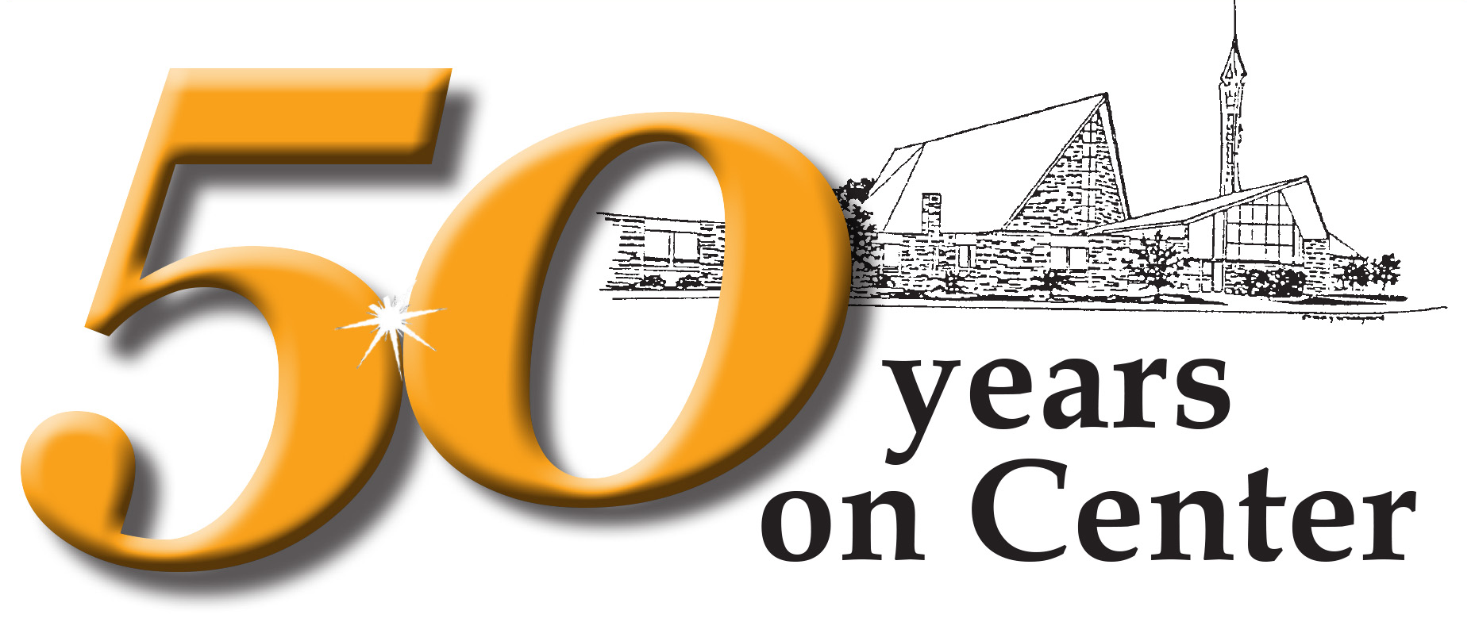
1969 2019
…the JOY continues!
WESLEY UNITED METHODIST CHURCH
Notes:
As we look back over the decades, we are filled with joy for the heritage we enjoy that is built on faith-filled vision, commitment and hard work. But great congregations do not exist in the past tense…today we move into a joyous future of great promise for Wesley United Methodist Church.

Slide 2
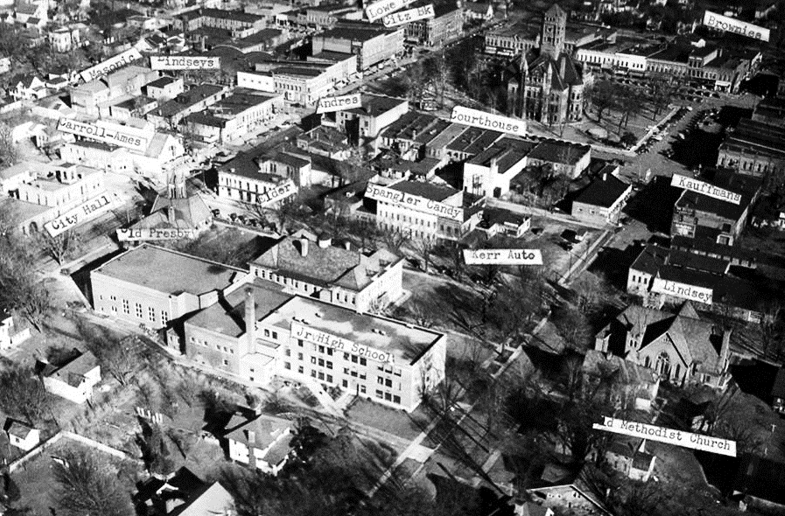

1969 2019
1965—no room to expand downtown
Notes:
…but in downtown Bryan, there was little available space for expansion. So discussion began to shift toward building a new facility in a different location.

Slide 3
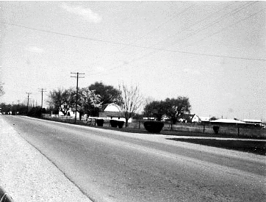
1969 2019
Donated property on Center St. extended
Notes:
J C Markey pledged a piece of property on the southwest outskirts of town, and finally in 1964 the site was approved and plans were drawn up—although many opposed the move as the land was “too far outside of town.”

Slide 4
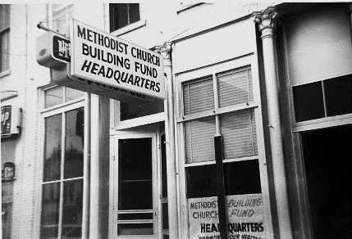

1969 2019
Fundraising is launched
Notes:
A downtown building became campaign headquartes…and section captains were assigned, each one to canvas a specific area.

Slide 5
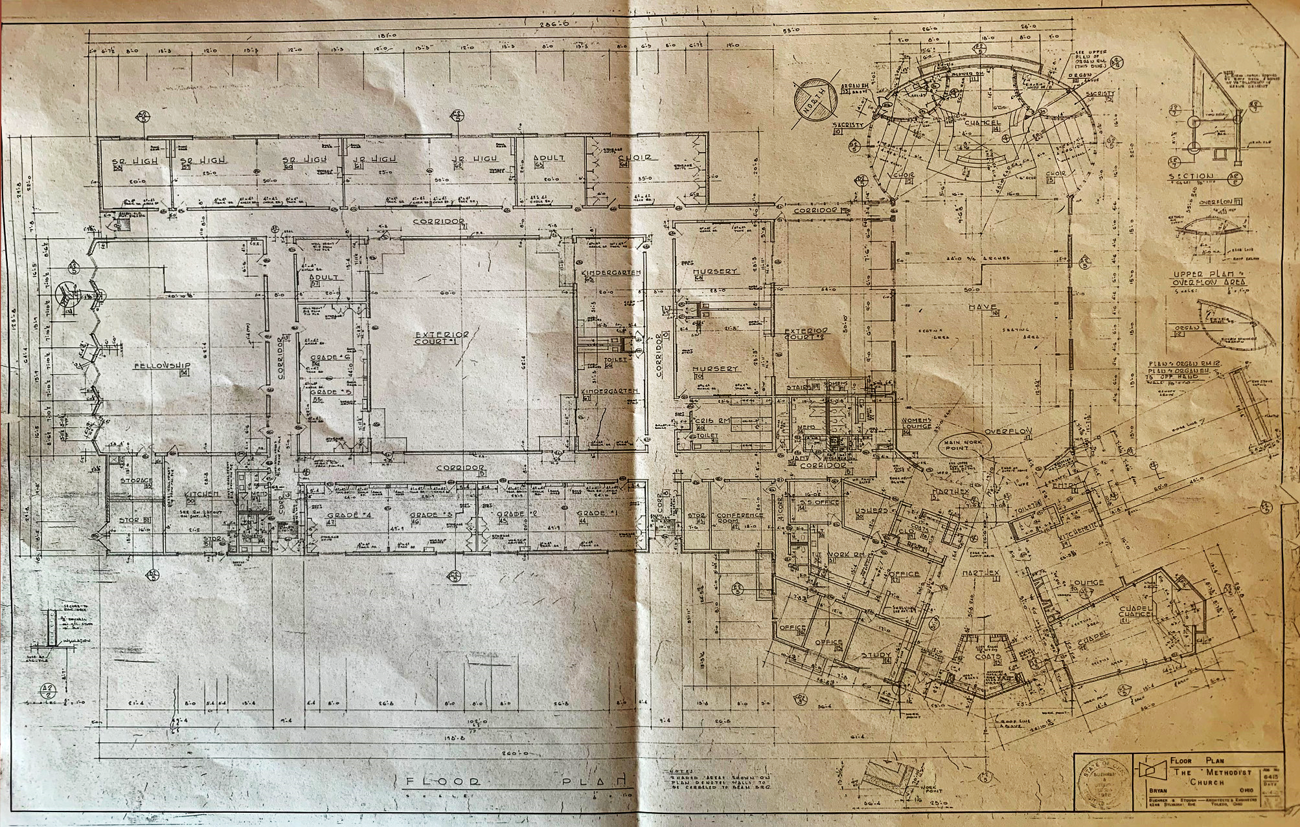
1969 2019
FELLOWSHIP
HALL
SANCTUARY
LOUNGE
KITCHEN
CLASSROOMS
OFFICES
CHAPEL
A one-story design unique to the area
Notes:
Our congregation, with the assistance of the architects, envisioned a unique church complex, unlike anything seen in our area. The 34,000 square foot structure included a sanctuary seating over 500, a chapel, a fellowship hall with attached kitchen, and 14 classrooms, along with offices and other meeting rooms.

Slide 6
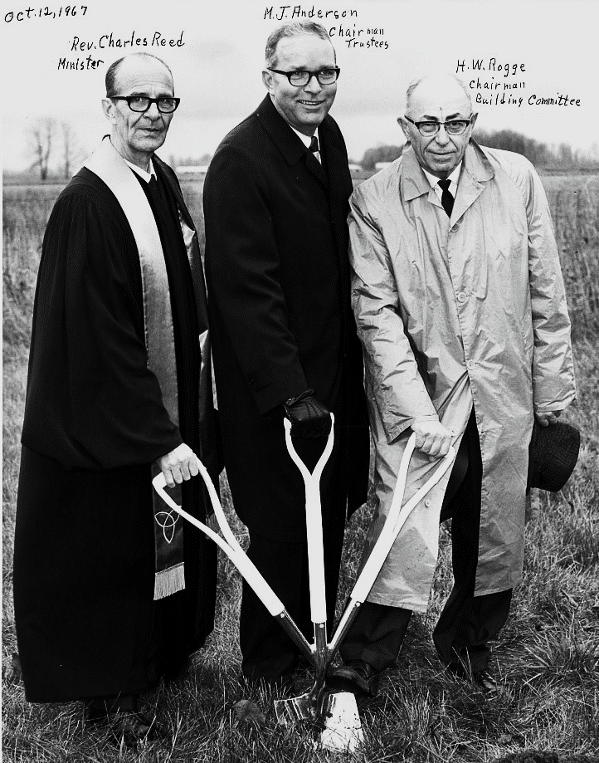
1969 2019
Groundbreaking for new church Oct. 1967
Notes:
Groundbreaking for the single story structure—unusual in those days—took place in October of 1967, and construction took two years.

Slide 7
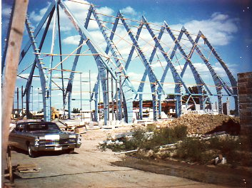
1969 2019
Buttresses shape the sanctuary
Notes:
The wooden buttresses that form the sanctuary skeleton were soon towering over the open field just off Center Street.

Slide 8
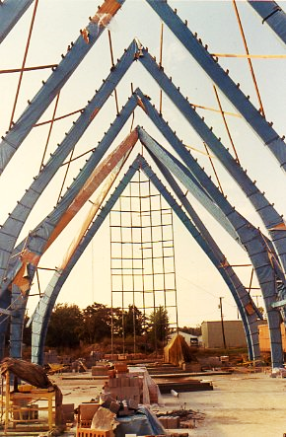
1969 2019
Buttresses are wrapped for weather protection
Notes:
As you can see the huge beams are wrapped to protect them from the elements.

Slide 9
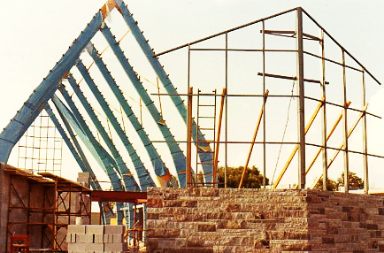
1969 2019
Window framework is part of structure
Notes:
While our previous buildings were called the wood and brick churches, this one was faced with granite, and became known as the granite church.

Slide 10
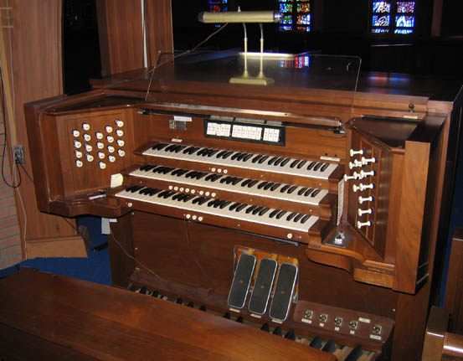
1969 2019
Möller pipe organ: 4 ranks, 1500+ pipes
Notes:
In the new church a glorious Moller organ was installed…and we are one of the few churches in the area with a pipe organ.

Slide 11
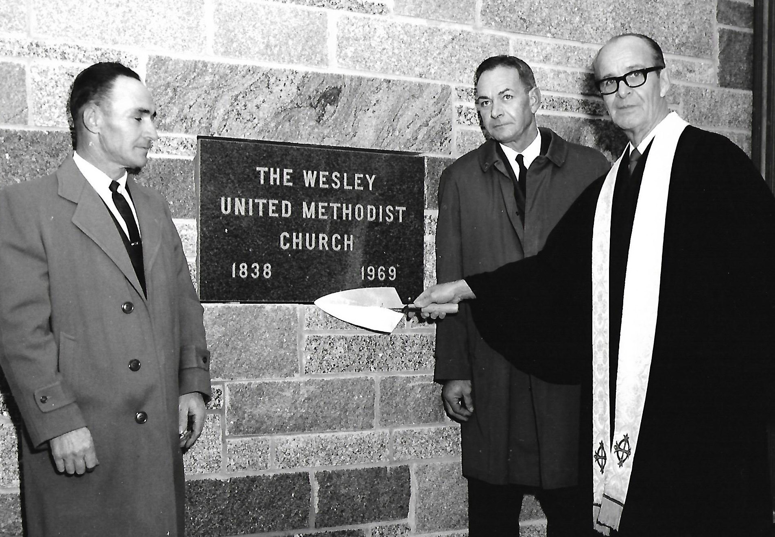
1969 2019
Cornerstone laid Nov. 21, 1969
Notes:
On November 21, 1969, the cornerstone of the brick church was opened, and many of the items along with mementos from 1969 were sealed in the granite church’s cornerstone.

Slide 12
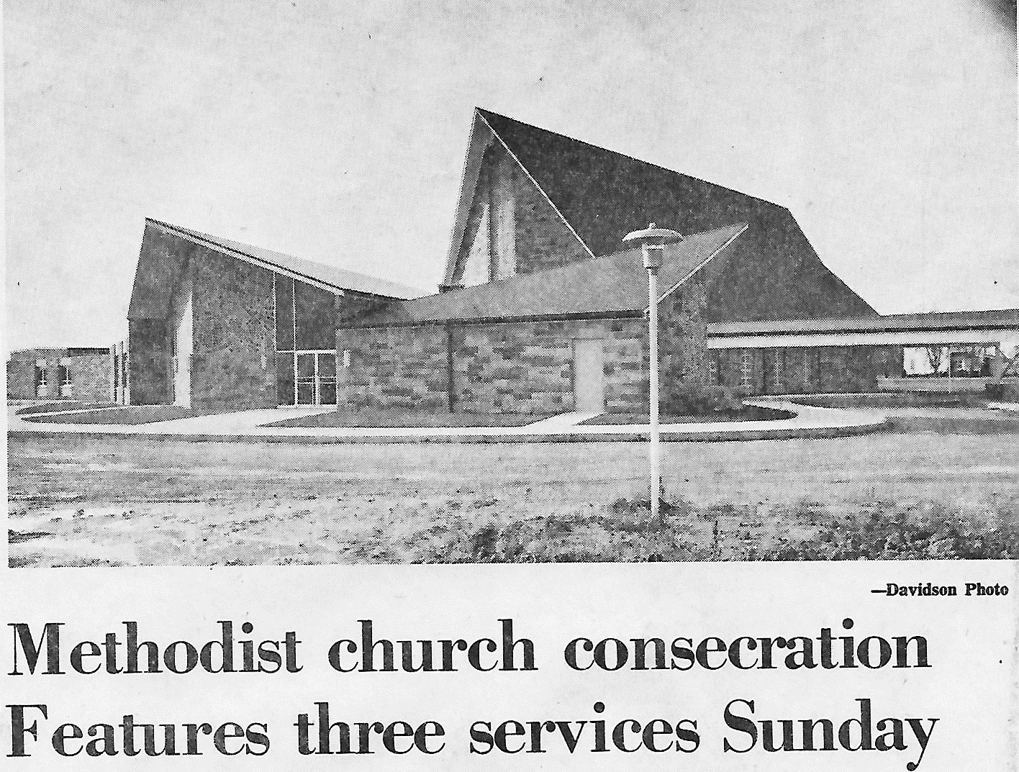
1969 2019
Consecration held on Nov. 30, 1969
Notes:
The new church was consecrated on Sunday, November 30, 1969. At the morning service, about 750 congregants and visitors filled the sanctuary…

Slide 13
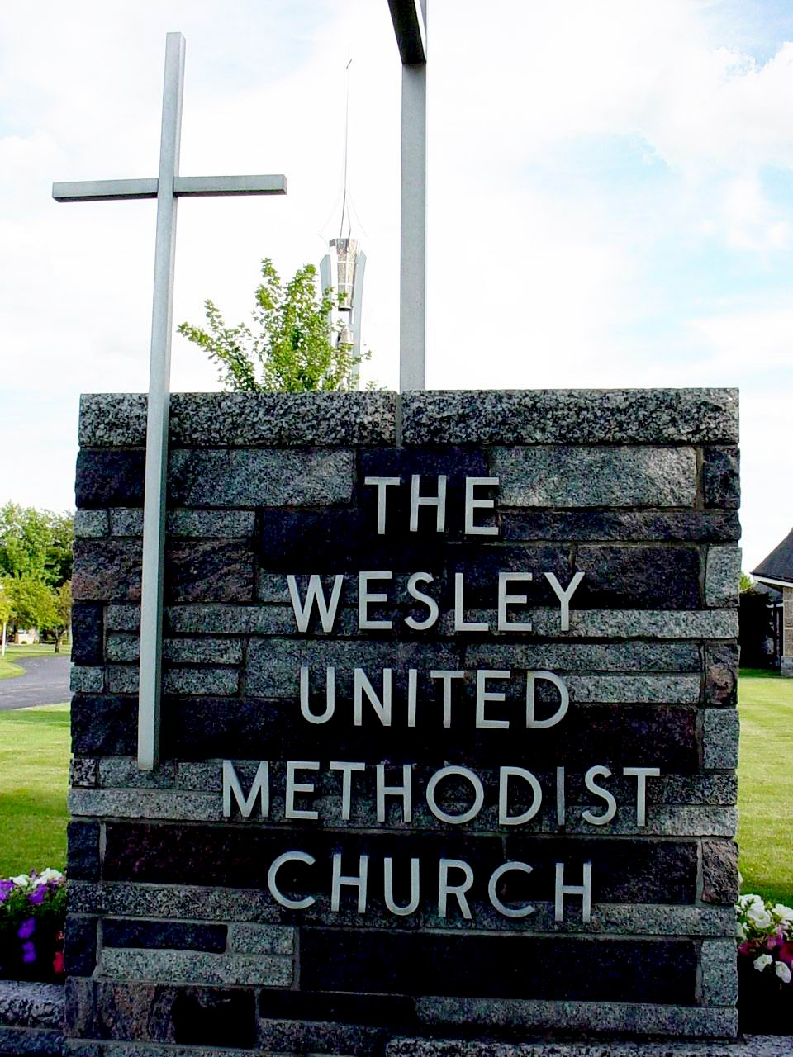
1969 2019
KNOW AS WESLEY
Our new name: Wesley United Methodist Church
Notes:
When the congregation of the First Methodist Church of Bryan dedicated its new facility, it also dedicated a new name: we are now The Wesley United Methodist Church.

Slide 14
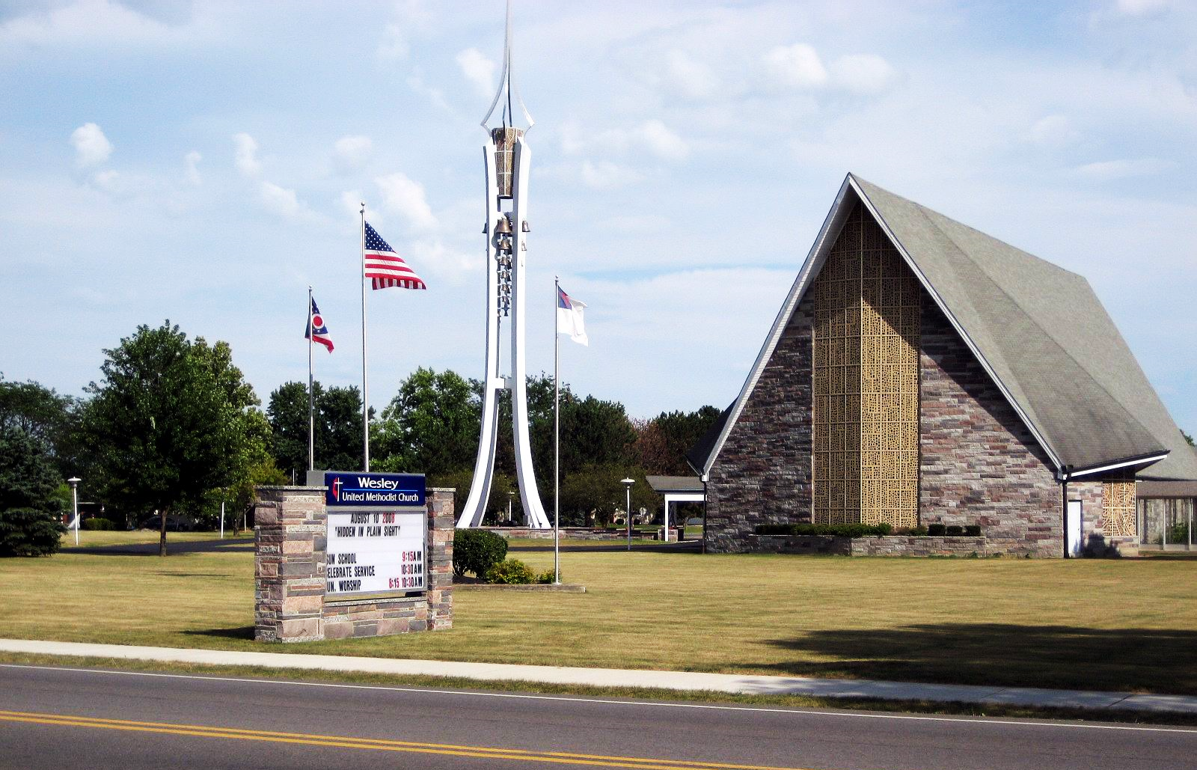
1969 2019
KNOW AS WESLEY
God’s church at 903 Center St. for 50 years
Notes:
When the congregation of the First Methodist Church of Bryan dedicated its new facility, it also dedicated a new name: we are now The Wesley United Methodist Church.

